Slide 1

Green Pace
Security Policy Presentation
Developer: Brandon Lombard

Slide 2

OVERVIEW: DEFENSE IN DEPTH
This model gives a detailed overview of the methods of defense that are used to maintain a solid level of protection for our organization.

Slide 3
THREATS MATRIX
Likely Threats that have a high chance of happening. | Priority Threats that are standard with high relevancy.
Low priority Threats that are standard with low relevancy. | Unlikely Threats that have a low chance of happening.
Secure coding standards have different levels of vulnerability to calculate the probability of an attack. This chart displays those priority levels.

Slide 4
10 PRINCIPLES
Validate Input Data
Heed Compiler Warnings
Architect and Design for Security Policies
Keep It Simple
Default Deny
Adhere to the Principle of Least Privilege
Sanitize Data Sent to Other Systems
Practice Defense in Depth
Use Effective Quality Assurance Techniques
Adopt a Secure Coding Standard

Slide 5
CODING STANDARDS
Data Type
Data Value
String Correctness
SQL Injection
Memory Protection
Assertions
Exceptions
Object Oriented Programming
Input Output (FIO)
Expressions

Slide 6
ENCRYPTION POLICIES
Encryption in rest – This type of encryption refers to when data is encrypted while it is stored. This encryption also prevents this data from being read if the proper key is not present. This is a great way to have additional layers of protection.
Encryptions at Flight – This ensures data is encrypted as it is being sent. However, the data is not as secured while it is stored or used. The data becomes encrypted while being sent to another storage location. This is a great way to protect data if it is intercepted with malicious intent. Particularly, this is a useful encryption method for those who work from home. This is because data can be secured as it is sent from the company network to the workers.
Encryption in Use – This method allows data to be encrypted while it is being used, where it can be accessed depending on the security level. This is great for company databases with creating some layers of protection, separating user and employee activity. Only higher-level employees can access the data if needed.

Slide 7
TRIPLE-A POLICIES
Authentication – This is important in that it allows users to access the system after they have proven they have access through login systems.
Authorization – This identifies the level of access given to a user. In this case, the administrator would have access to most items such as databases, secure files, customer records, etc. The administrator is also allowed to make changes to the system by adding and deleting items, to include user accounts. Lower-end users would have much less authorization in the system.
Accounting – Accounting allows for the keeping of records for when data has been changed in a system, and which user has made those changes. This allows for a record of certain changes, so if someone makes a mistake, or does something malicious, it can be addressed and who did it can be known.

Slide 8
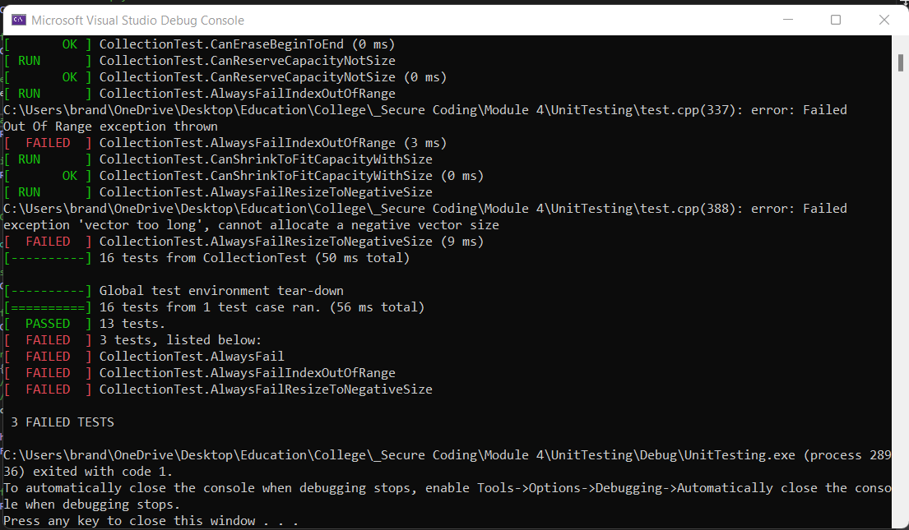
Bad Data Unit Testing
This unit test involved creating positive and negative tests to prove if an error or exception happens when provided with bad data.

Slide 9

AUTOMATION SUMMARY

Slide 10
TOOLS
The DevSecOps Pipeline is a method of secure coding where there is a multi-step approach for security. Included are typically four phases, such as Plan, Code, Build, Test, then Release and Deploy.
The diagram showcases the suggested steps in writing secure code and protecting your organization from malicious attempts.
Pre-production includes planning, test-driven design, secure building, and verify and test.
Production includes configuration and deployment, then monitoring and detecting hacking attempts. Then, developers should consistently monitor hacking attempts and respond to those attempts. Finally, maintaining security standards and ensuring

Slide 11
RISKS AND BENEFITS
If you act now, the risks are lessened, but if you wait, you have a much higher chance of your systems being hacked.
While there is always going to be a risk, having a plan in place is highly important.
On the other hand, if you act now, you may not know the total risks before a hacker attempts to break into your system.
You could waste time and money trying to prepare for a hacking attempt when you don’t fully know what areas need improvement.
To combat this, understanding the possible motives while keeping up with the most common risks today is a great place to start.

Slide 12
RECOMMENDATIONS
While having a plan in place is essential in protecting your systems from hacking, it is important to continuously improve the plan and update it as needed.
Having one set-in-stone plan isn’t always the best option. Continuing education is highly important for the success of the organization.
Staying in sync with societal trends allows the organization to be fully prepared when it comes to secure coding.
Ensure that you are utilizing a multi-layer approach and using best coding practices.

Slide 13
CONCLUSIONS
While all standards should be used in developing secure code, there are a few that have a higher level of importance and in turn should be adopted to prevent future problems.
Data Type – defining specific data types and not casting to an out-of-range enumeration value helps prevent further issues in your code.
SQL Injection – This is a popular one that needs to be addressed.
Memory Protection – Prevent memory allocation errors, which can cause a heap of errors in your code.
Exceptions – Honoring exception specifications.

Slide 14
REFERENCES
Agarwal, H. (2021, September 29). Why do hackers hack? [5 big reasons explained]. Appknox. Retrieved April 17, 2022, from https://www.appknox.com/blog/why-do-hackers-hack
Khagram, A. (2017, February 3). The motivations of a Hacker. swcomms. Retrieved April 17, 2022, from https://www.swcomms.co.uk/blog/article/the-motivations-of-a-hacker

